Slide 1
Gene Set Enrichment Analysis
Project: Differential Gene Expression and Pulmonary Function in Vaping LatinX Adolescents Analyst: Trent Hawkins Investigator(s): Sunita Sharma, MD; Sarah Commodore, Ph.D

Slide 2
Introduction
The purpose of this report is to identify differentially enriched biological pathways using Gene Set Enrichment Analysis (GSEA).

Slide 3
Methods (Package and Pathway Versions)
Packages
fgsea ver. 1.20.0 – used to conduct GSEA
biomaRt ver. 2.50.3 – used to retrieve KEGG and GO pathways
reactome.db ver. 1.77.0 – used to retrieve Reactome pathways
Pathways
KEGG: Release 102.0 (Retrieved 06/20/2022)
Reactome: Release 77 (Retrieved 06/29/2022)
GO: Version 14 (Retrieved 06/20/2022)

Slide 4
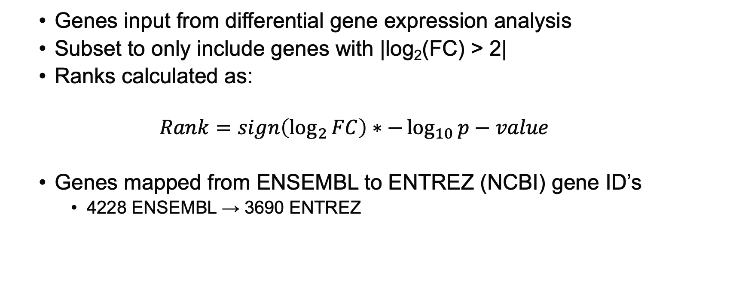
Methods
Genes input from differential gene expression analysis
Subset to only include genes with |log₂(FC) > 2|
Ranks calculated as:
$$Rank=sign\left(\log_{2}{FC}\right)∗−\log_{10}{p−value}$$
Genes mapped from ENSEMBL to ENTREZ (NCBI) gene ID’s
4228 ENSEMBL → 3690 ENTREZ

Slide 5
Methods
GSEA Parameters:
Only pathways with ≥ 2 genes present in the ranks were considered for analysis
After GSEA, pathways were ‘collapsed’ to include only independent pathways

Slide 6
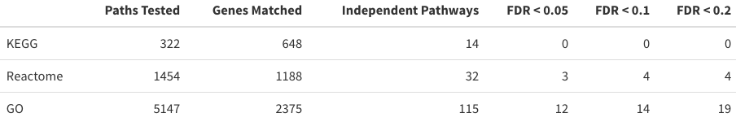
Summary Statistics
Genes Included in Analysis: 3690
Paths Tested: Total pathways tested
Genes Matched: Total genes matched to any tested pathway
Independent Pathways: Number of pathways after ‘collapsing’ to include only independent pathways
FDR : Total number of Significant pathways at the indicated level

Slide 7
Some Definitions…
Enrichment Score (ES): the degree that the gene set for the term is over-represented.
Normalized Enrichment Score (NES): the enrichment score normalized to the mean enrichment of random samples of the same size.
Size: The number of genes in the ‘leading edge’.
Leading Edge: genes that account for the gene set’s enrichment signal.
All definitions above provided by Cheyret Wood

Slide 8
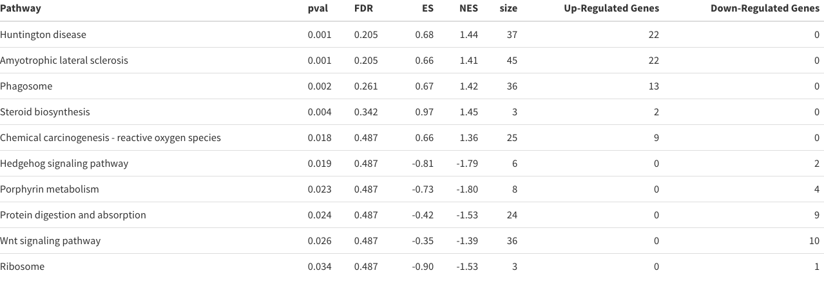
KEGG Pathways (Top 10)

Slide 9
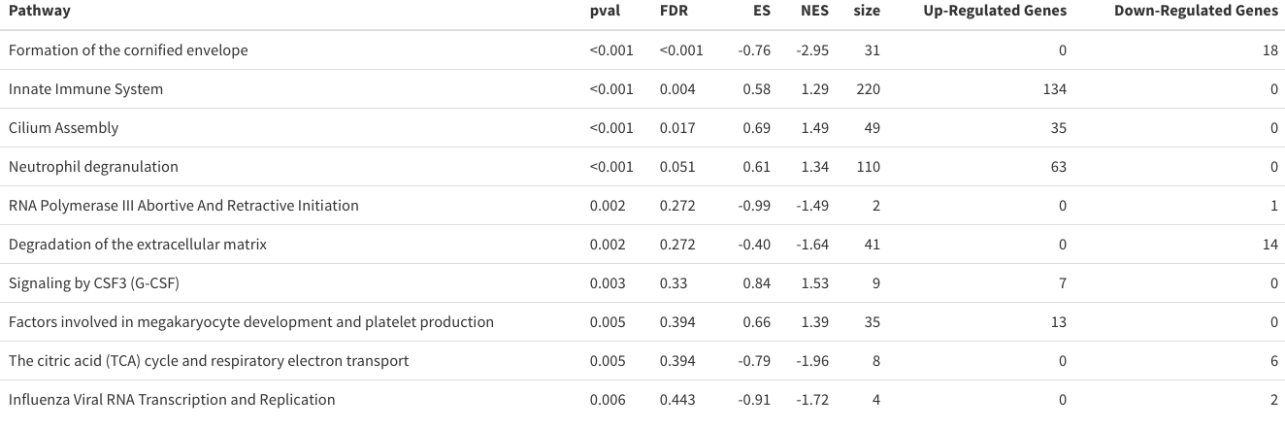
Reactome Pathways (Top 10)

Slide 10
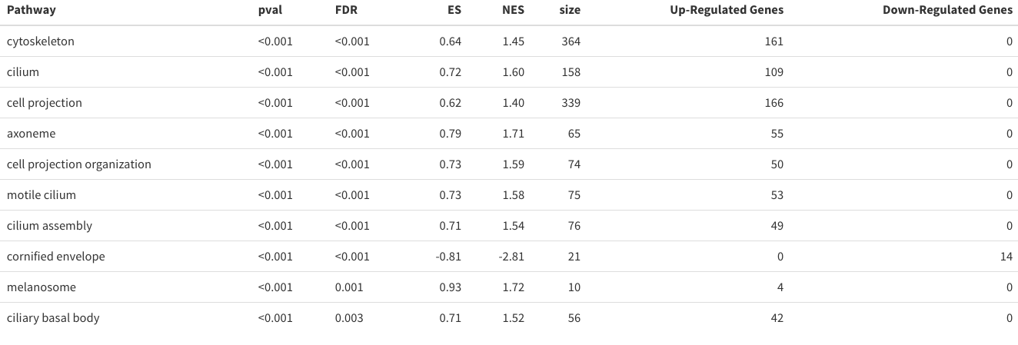
GO Pathways (Top 10)

Slide 11
Conclusion

